Slide 1
Deep Learning & Object Recognition
PROJECT
BENJAMIN SENG
Here we go…

Slide 2
Table of contents
01
02
03
Introduce
Fine-Tuning
Data Pre-Process
06
07
Evaluation & Analysis
Android Deployment
Conclusion
04
Baseline
What I chose for to be the baseline models
What are the different tuning techniques
Steps to explore the
datasets and the pre-processing of data
05
08
Complex Model
What did I do to make the model “complex”

Slide 3
01
Introduction
What is Cifar-10 Dataset and its use case?

Slide 4
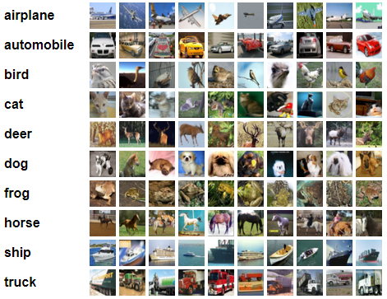
What is Cifar10 and Use Case?
CIFAR-10 dataset:
Consists of 60,000 color images.
Images are 32x32 pixels in size.
Categorized into 10 distinct classes.
Each class has 6,000 images.
Represents everyday objects and animals.
Classes include airplanes, automobiles, birds, cats, deer, dogs, frogs, horses, ships, and trucks.
Widely used benchmark dataset in computer vision and machine learning & can be used to evaluate the performance of different machine learning algorithms and techniques.
Dataset split
Training set: 50,000 images.
Test set: 10,000 images.
Allows accurate evaluation of models on unseen data.
Use Cases:
Algorithm Evaluation and Comparison: Facilitates fair performance assessment and comparisons in image classification.
Education and Research: Supports university-level education and research in computer vision.
Transfer Learning and Pre-training: Enables faster model development
Transfer Learning and Pre-training: Enables faster model development and fine-tuning for specific tasks.
fine-tuning for specific tasks.

Slide 5
02
Data Pre-Processing
Steps to explore the
datasets and the pre-processing of data

Slide 6

Data Pre-processing Steps
Necessary Steps :
Importing important packages in Python
Essential packages imported in Python for simplicity and uniformity in structure.
Loading in Cifar-10 Dataset:
Downloading and loading the dataset into the Python environment for further processing and analysis.
Visualizing the data:
Displaying sample images from the dataset to gain a visual understanding of the data and the variety of classes present.
Pre-processing Steps :
Normalization
Scaling pixel values from 0-255 to 0-1 range for effective model training by dividing each value by the maximum value (255).
Apply for all models
Convert labels to one-hot encoding
Converting categorical labels into binary vectors to represent class membership in multi-class classification tasks.
Apply for all models
Reshape the images
Modifying image dimensions to match the model's input shape requirement, ensuring proper data processing and compatibility.
Was done for AlexNet and Inception-V3

Slide 7
03
Baseline Models
What I chose for to be the baseline models?

Slide 8
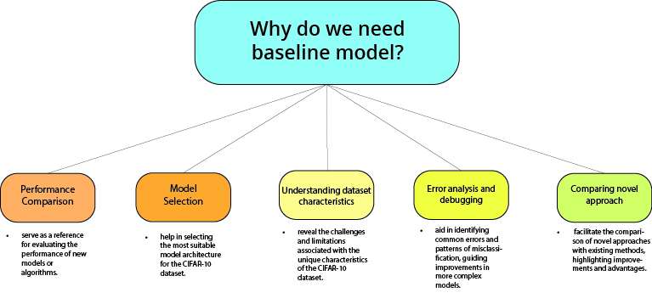

The Architecture used
AlexNet
Deep convolutional neural network with eight layers
GoogLeNet
known for its inception modules, enabling efficient representation learning in deep convolutional neural networks.
Inception-V3
incorporates inception modules as well and plays a crucial role in image classification and feature extraction tasks
Lenet-5
handwritten digit recognition, consisting of multiple convolutional and pooling layers followed by fully connected layers
VGGNet
its simplicity and uniform structure, consisting of multiple convolutional layers with small filter sizes and max pooling layers.

Slide 9
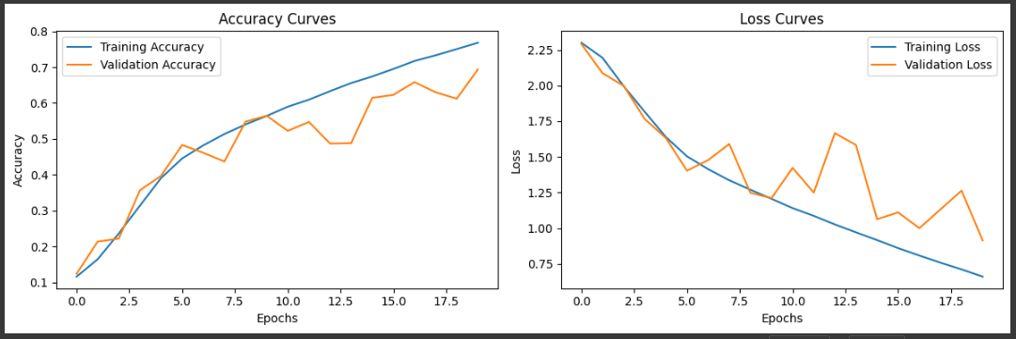
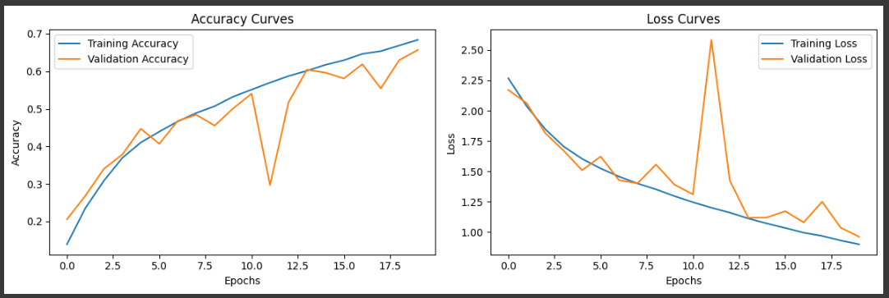
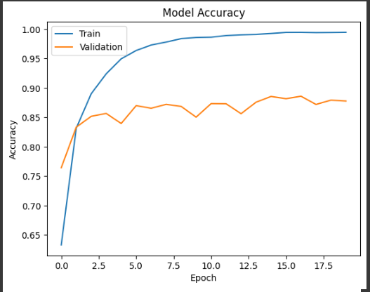
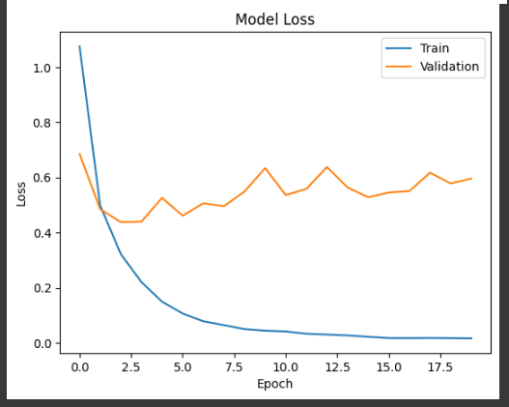
baseline models benchmarks
Used for basic testing:
epoch = 20, batch size 64, Optimizer = SGD, loss = categorical_crosssentropy
Model | Base Benchmark
AlexNet | Test Loss: 0.9141594767570496 Test Accuracy: 0.6934999823570251
GoogLeNet | Test Loss: 0.9612329006195068 Test Accuracy: 0.6567000150680542
Inception-V3 | Test loss: 0.5961021780967712 Test accuracy: 0.8779000043869019
ISSUES
At epoch 1, the model starts with low accuracy values for both training and validation sets.
the gap between the training and validation accuracies starts to increase after a few epochs, around 5. Indicating potential overfitting
At epoch 20, the training accuracy is higher than the validation accuracy (76.79% vs. 69.34%).
The validation accuracy also improves but plateaus around 65.67%, indicating possible overfitting.
There are signs of overfitting since the model achieves higher accuracy on the training set compared to the validation set
The validation accuracy also improves but plateaus around 87.79%, indicating possible overfitting
There are signs of overfitting since the model achieves significantly higher accuracy on the training set compared to the validation set.
Achieves a high training accuracy of approximately 99.47% at the final epoch. Suggests that the model can effectively fit the training data, but it may struggle to generalize well to unseen data.

Slide 10
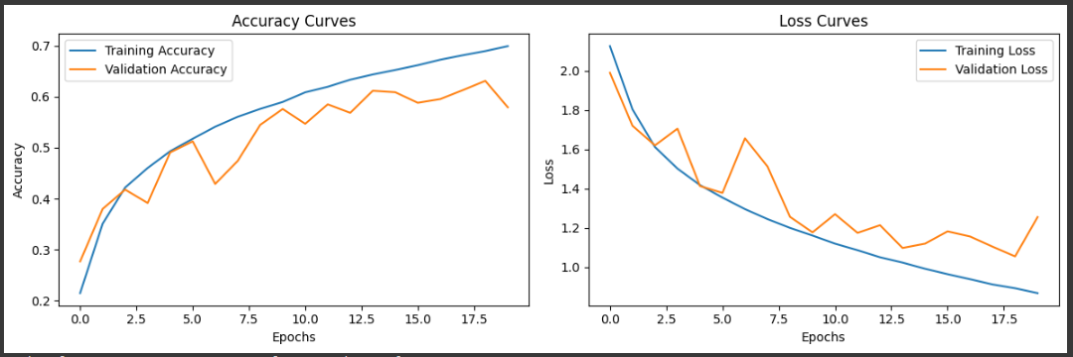
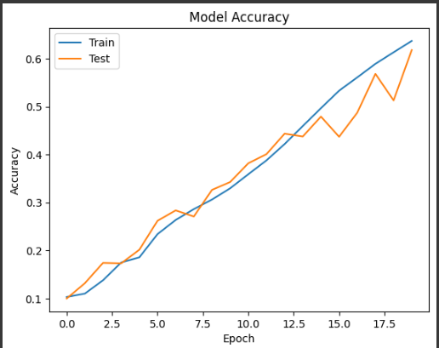
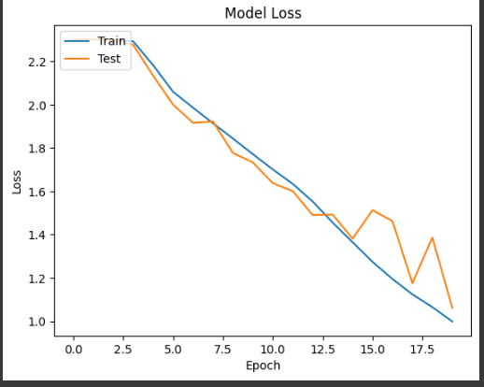
baseline models benchmarks
Used for basic testing:
epoch = 20, batch size 64, Optimizer = SGD, loss = categorical_crosssentropy
Model | Base Benchmark
LeNet-5 | Test Loss: 1.2559585571289062 Test Accuracy: 0.5791000127792358
VGGNet | Test Loss: 1.061872124671936 Test Accuracy: 0.617900013923645
ISSUES
Both training and validation accuracies are relatively low, indicating that the model struggles to learn complex patterns in the data.
There is a clear sign of overfitting. The model achieves significantly higher accuracy on the training set compared to the validation set.
This discrepancy between training and validation accuracy suggests that the model is memorizing the training data rather than generalizing well to unseen examples
The model's performance does not appear to stabilize or converge within the given 20 epochs and learning rate. validation accuracy does not show consistent improvement throughout the epochs, and it remains relatively low
training accuracy is significantly higher than the validation accuracy, suggesting the potential presence of overfitting.
There are signs of overfitting since the model achieves significantly higher accuracy on the training set compared to the validation set.
The model's ability to memorize the training data might hinder its ability to generalize to new examples.
The model might be underfitting the data initially, as the training and validation accuracies are quite low in the early epochs.

Slide 11
Fine-Tuning
04
What are the different tuning techniques I did?

Slide 12

All the fine tuning techniques researched
What worked for all models?
What solve or at least helped with overfitted graphs?
Data Augmentation
a technique to increase training data diversity by applying transformations like rotation, flipping, and scaling.
Regularization
Adding a penalty term (such as L1 or L2 regularization) to the loss function to constrain the model's parameters combats overfitting by reducing model complexity.
Batch Normalization
combats overfitting by reducing internal covariate shift, improving generalization, and stabilizing learning through normalizing inputs in each layer of the neural network.
Early Stopping
a technique used to prevent overfitting by stopping the training process when the model's performance on validation data starts deteriorating
Dropout
combat overfitting by randomly disabling a fraction of the neurons during training, forcing the network to learn more robust and generalized representations.
Learning Rate Schedulers
a technique used to prevent overfitting by stopping the training process when the model's performance on validation data starts deteriorating
Learning Rate
combat overfitting by randomly disabling a fraction of the neurons during training, forcing the network to learn more robust and generalized representations.
Hyper Parameter
Hyperparameter tuning: Optimizing hyperparameters (such as learning rate, batch size, regularization strength)
will be discussed in the next slide…

Slide 13
All the Hyperparameters that were researched and used
Learning Rate
The learning rate determines the step size at each iteration during gradient descent.
Optimizer
The optimizer determines the algorithm used to update the model's weights based on the computed gradients.
Popular choices include stochastic gradient descent (SGD), Adam, RMSprop
Number of Epochs
The number of epochs defines how many times the model will iterate over the entire training dataset.
Batch Size
The batch size determines the number of samples processed before the model's weights are updated.
Data Augmentation
Data augmentation techniques can artificially increase the diversity of the training data by applying random transformations.
Common augmentations include random flips, rotations, zooms, shifts, etc.
Model Architecture
The choice of model architecture greatly affects performance.
You can experiment with different architectures, such as convolutional neural networks (CNNs), varying the number of layers, types of layers (convolutional, pooling, fully connected), and their sizes as well as adding more dense layers.
Activation Functions
The choice of activation functions within the model's layers can affect its ability to learn complex representations.
Popular choices include ReLU (Rectified Linear Unit), LeakyReLu
Dropout Rate
Dropout is a regularization technique that randomly sets a fraction of input units to 0 during training to prevent overfitting.
Early Stopping
Early stopping is a technique to prevent overfitting by monitoring the model's performance on a validation set and stopping training when the performance plateaus.
define a patience parameter, which determines the number of epochs to wait for improvement before stopping training.
Weight Regularization
Weight regularization adds a penalty term to the loss function to prevent the model's weights from becoming too large.
experiment with L1 or L2 regularization and adjust the strength of the regularization term
Input Image Size
The size of input images can impact the model's performance.
If the architecture only allow a certain amount of input shape, use the lowest input shape, work closer to 32x32 input which is Cifar-10 dataset input shape for better results
Transfer Learning:
Transfer learning allows leveraging pre-trained models on larger datasets, such as ImageNet, to benefit from learned Transfer learning allows leveraging pre-trained models on larger datasets, such as ImageNet, to benefit from learned features.

Slide 14
05
Complex Models
What did I do to make the model “complex”

Slide 15




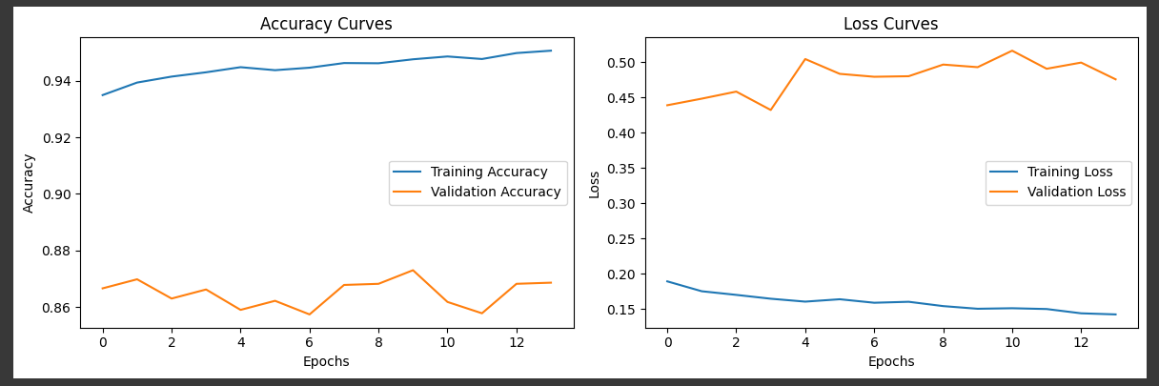


AlexNet Complex Model
What was used to complexify the model?
Before Changes
Model Architecture:
Difference is in the pool size of the second MaxPooling2D layer. It has a pool size of (3,3)
This change affects the size of the output feature maps after the MaxPooling2D layers. A smaller pool size can result in more aggressive downsampling and may capture more local information, while a larger pool size can retain more spatial information.
Incorporating Data Augmentation:
data augmentation is applied using the ‘ImageDataGenerator’ class, which performs various random transformations on the training data such as rotation, shifting, and flipping.
Incorporating Early Stopping:
implements early stopping using the 'EarlyStopping' callback.
The best performing weights are restored using 'restore_best_weights=True.’
I believe this was the best tuning, 'early_stopping = EarlyStopping(monitor='val_loss', patience=10, restore_best_weights=True)'.
After Changes
Incorporating Learning Rate Scheduler:
defines a learning rate scheduler using the scheduler function.
I believe best learning rate is reduced by a factor of tf.math.exp(-0.1) after 15 epochs.
This approach is based on the intuition that initially, a higher learning rate helps the model converge faster, but as training progresses, a lower learning rate allows for fine-tuning and better convergence.

Slide 16
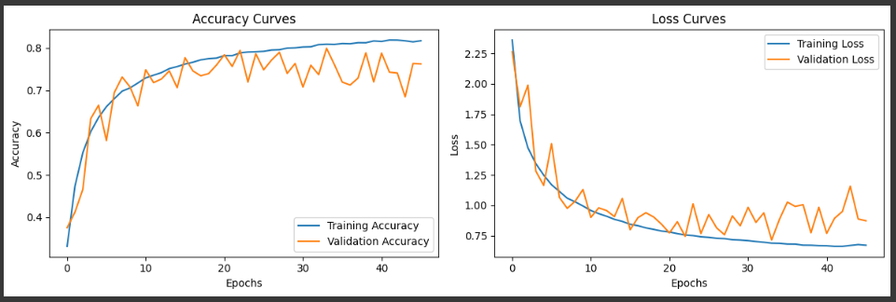
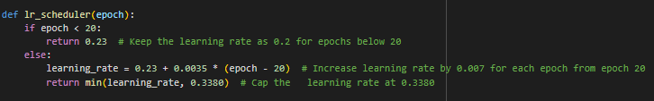
GoogLeNet Complex Model
What was used to complexify the model?
Model Architecture:
Batch Normalization: Normalizing outputs for faster convergence and better generalization.
Activation Function: Applying separate activation functions after each layer.
Regularization: Adding L2 regularization for better model performance and prevention of overfitting.
Pre-trained Model: Utilizing pre-trained model as a starting point for GoogLeNet architecture.
Dropout: Applying dropout regularization to prevent overfitting in the network.
Before Changes
Incorporating Transfer Learning (ResNet50):
Incorporating transfer learning with ResNet50 in GoogLeNet boosts performance, reduces training time, enhances generalization, and transfers valuable knowledge from pre-trained models for improved results on specific tasks.
After Changes
Incorporating Data Augmentation:
Similar to AlexNet’s Data Augmentation, however the only variable was rotation_range = 20
Incorporating Early Stopping:
I believe this was the best tuning, 'early_stopping = EarlyStopping(monitor='val_loss', patience=12, restore_best_weights=True)’.
The rest of the Early Stopping was similar to AlexNet’s Early Stopping
Incorporating Learning Rate Scheduler:
defines a learning rate scheduler using the scheduler function.
I believe this is the best learning rate adjustment

Slide 17

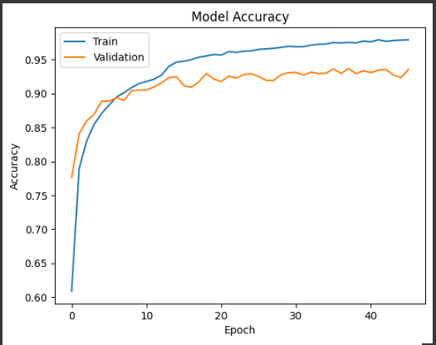
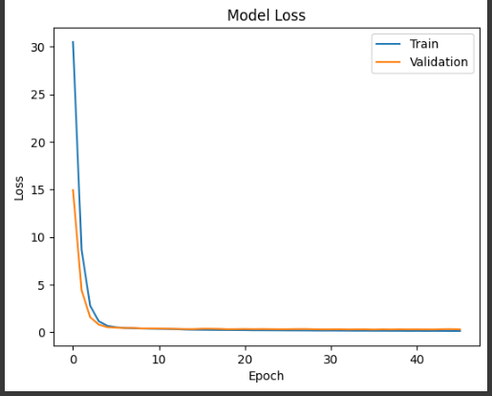

InceptionNet Complex Model
What was used to complexify the model?
Before Changes
Model Architecture:
Increased Dense Units: The number of units in the Dense layers has been increased. In the first model, the last Dense layer had 1024 units, while in the second model, there are multiple Dense layers with varying numbers of units, such as 4096, 2048, 1024, and 512.
Regularization: The ‘kernel_regularizer’ argument has been added to the Dense layers in the second model. In this case, the L2 regularization with a coefficient of 0.007 is applied.
Dropout Layers: Dropout layers have been introduced in the second model after the Dense layers. The dropout rates have been adjusted to 0.3, 0.2, and 0.15 in the respective dropout layers.
Additional Dense Layer: An extra Dense layer with 512 units has been added to the second model.
Incorporating Data Augmentation: An ImageDataGenerator is created with various augmentation options, including rotation, width and height shifting, horizontal flipping, and zooming. (Rotation_range = 15)
Incorporating Early Stopping: Same as AlexNet
After Changes
Incorporating Learning Rate Scheduler:
defines a learning rate scheduler using the scheduler function.
I believe this learning rate which starts at 0.03 and is reduced to 0.022 after 13 epochs. This adjustment helps the model to converge faster and potentially reach a better optimum.
Dynamic Batch Size:
The ‘batch_size’ variable is introduced to define the number of samples per gradient update.
In the improve code, a value of 32 is used, which can be adjusted based on memory constraints and computational resources.
Using a smaller batch size can provide better generalization, while larger batch sizes may speed up the training process.

Slide 18




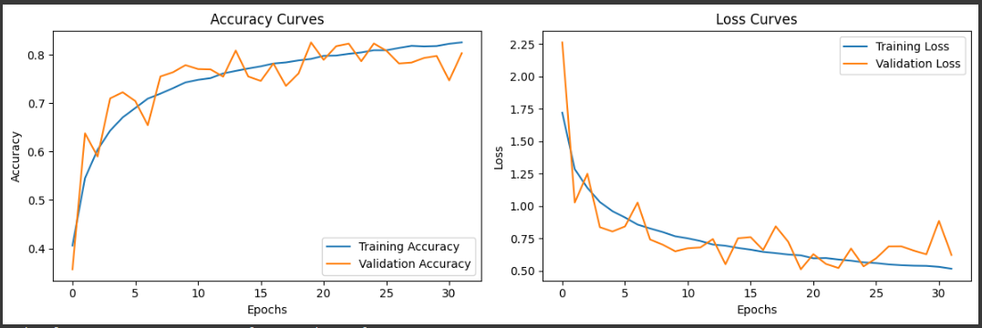

LeNet-5 Complex Model
What was used to complexify the model?
Before Changes
Model Architecture:
Fully Connected Layers: The number of units in the Dense layers has been increased. In the first model, the last Dense layer had 1024 units, while in the second model, there are multiple Dense layers with varying numbers of units, such as 4096, 2048, 1024, and 512.
Dropout Regularization: The ‘kernel_regularizer’ argument has been added to the Dense layers in the second model. In this case, the L2 regularization with a coefficient of 0.007 is applied.
Incorporating Data Augmentation: Same as Inception-V3.
Incorporating Early Stopping:
implements early stopping using the 'EarlyStopping' callback.
The best performing weights are restored using 'restore_best_weights=True.’
I believe this was the best tuning, 'early_stopping = EarlyStopping(monitor='val_loss', patience=12, restore_best_weights=True)'.
After Changes
Optimizer Change:
The optimizer is changed from SGD (Stochastic Gradient Descent) to Adam optimizer (optimizer='adam'). Adam optimizer is known for its efficiency and adaptive learning rate, which can often lead to faster convergence and better performance.
Increase number of epochs:
The number of training epochs is increased to 100 in the second model. This allows the model to train for a longer duration and potentially achieve better performance.

Slide 19
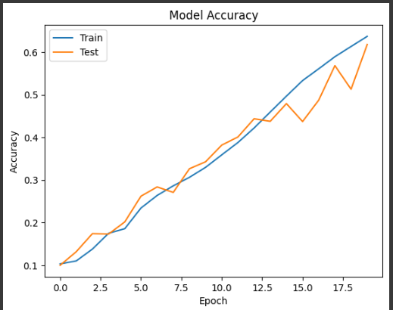
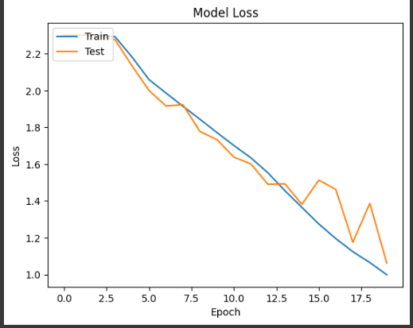

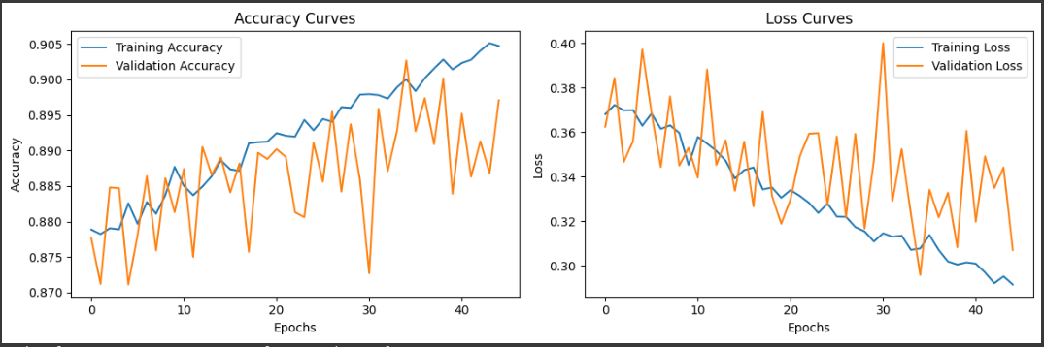
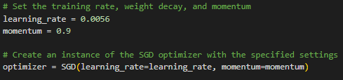

VGGNet Complex Model
What was used to complexify the model?
Model Architecture:
Batch Normalization: Batch normalization is added after each convolutional layer
Dropout: Dropout layers are added after each max pooling layer
Reduce Model Complexity : has fewer convolutional layers compared to the baseline model
Dropout Rate: has higher dropout rates compared to the baseline model.
Fully Connected Layers: has fully connected layers with 512 units instead of 4096 units. in the baseline model.
Before Changes
The other minor changes: Pooling Layers, Dropout Placement, Dropout rates, Dense Layers
Incorporating Data Augmentation: Same as all the others, however one parameter tune was rotation_range=12
Incorporating Early Stopping:
implements early stopping using the 'EarlyStopping' callback.
The best performing weights are restored using 'restore_best_weights=True.’
I believe this was the best tuning, 'early_stopping = EarlyStopping(monitor='val_loss', patience=10, restore_best_weights=True)'.
After Changes
Different Batch Size: The batch size was set to 32 instead of 64 in the baseline model. Reducing the batch size can help in better generalization and convergence of the model, especially when combined with data augmentation.
Incorporating Custom Learning Rate for Optimizer:
the optimizer is created with a specified learning rate of 0.0056 and momentum of 0.9. Using a customized learning rate and momentum allows for more fine-tuning of the optimization process.
Notes:
Pooling Layers: In the first model, the max pooling layers have a stride of (2, 2), which means they reduce the spatial dimensions (width and height) by a factor of 2. In the second model, the max pooling layers do not specify the stride parameter, which means the default stride of (1, 1) is used. This results in a smaller reduction in spatial dimensions.
Dropout Placement: In the first model, the dropout layers are placed after the fully connected layers, while in the second model, dropout layers are placed after the max pooling layers. Placing dropout after the max pooling layers allows for regularization at an earlier stage in the network, potentially preventing overfitting and improving generalization.
Dropout Rates: The dropout rates in the second model are specified as 0.5, 0.7, 0.7, and 0.6, respectively. These rates indicate the fraction of input units to drop during training. The higher dropout rates in the second model suggest a more aggressive regularization approach.
Dense Layers: The first model has two fully connected layers with 4096 units each, whereas the second model has two fully connected layers with 512 units each. Reducing the number of units in the dense layers can help in reducing the model's parameter count and computational complexity, which may lead to faster training and inference.
Model Size: The second model is likely to be smaller in terms of the number of parameters compared to the first model due to the reduced number of filters in convolutional layers and the smaller size of the dense layers.
These additional changes contribute to the overall differences between the two models and further affect their training dynamics and performance.

Slide 20
06
Evaluation & Analysis
evaluate the model and provide a deep analysis

Slide 21
Model Evaluation & Analysis : Choosing Inception V3
Reasons for Choosing Inception V3 over VGG:
Accuracy:
Inception V3 demonstrated the highest accuracy among the evaluated models.
Accurately detecting and classifying CIFAR-10 images was a critical objective.
Performance:
Inception V3 showed relatively fast execution compared to other models.
Efficient performance contributed to its suitability for the project.
Comparison of Models:
AlexNet and GoogLeNet:
Originally designed for higher-resolution images.
Expected to perform worse on the CIFAR-10 dataset due to its lower resolution (32x32).
Underperformed below 90% accuracy.
LeNet-5:
Simple architecture with limited complexity.
Not ideal compared to more sophisticated models like VGGNet and Inception V3.
Based on these considerations, I concluded that Inception V3 was the optimal choice for my project. Its slightly higher accuracy, computational efficiency, and compatibility with the CIFAR-10 dataset provided a compelling rationale for selecting Inception V3 over the other models.

Slide 22
07
Android Deployment
What I chose for to be the baseline models?

Slide 23

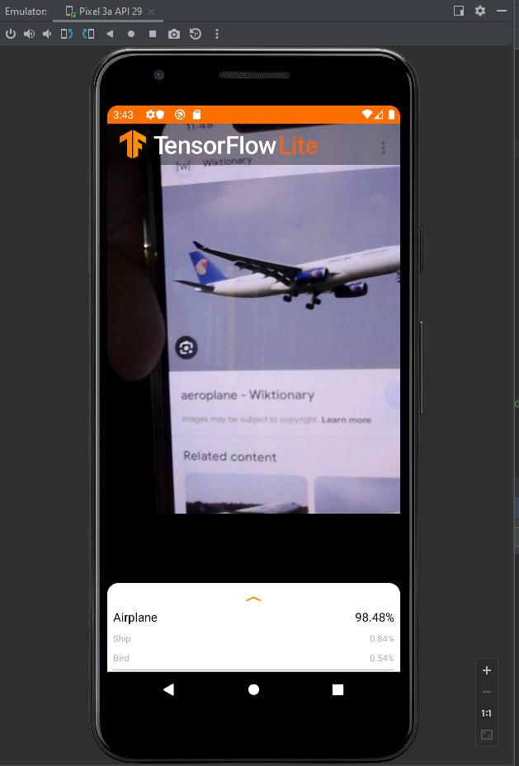
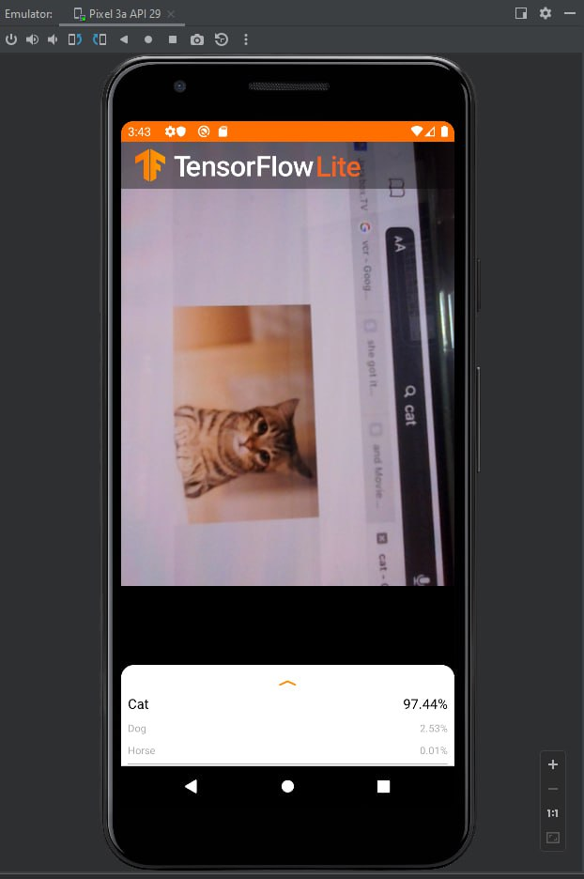
Android Deployment

Slide 24
Conclusion
08
what went wrong and what you would have done differently if given
more time

Slide 25

Conclusion of the project
Despite my considerable efforts and belief in the outstanding quality of my image classification project for the CIFAR-10 dataset, there were a few challenges that proved to be daunting. Given more time, here are some aspects I would have approached differently:
Model Architecture Exploration: Although I dedicated substantial effort to designing and fine-tuning the model architecture, more time would have allowed me to explore a wider range of architectures. This would have enabled me to experiment with more complex or novel models, potentially improving the overall performance and accuracy of the classification.
Ensemble Learning: Given more time, I would have explored the potential of ensemble learning. Building an ensemble of multiple models with different architectures or training variations often leads to enhanced performance and improved robustness. Unfortunately, due to time constraints, I was unable to implement this technique in my project.
Hyperparameter Optimization: While I made significant strides in optimizing the model's hyperparameters, further time would have allowed for more exhaustive exploration of hyperparameter configurations. This would have involved conducting systematic searches and leveraging advanced techniques like Bayesian optimization or automated neural architecture search, potentially leading to even better results.
Despite these challenges, I firmly believe that my project demonstrates my dedication, perseverance, and ability to tackle complex image classification tasks. With additional time, I would have tackled these aspects differently to further enhance the model's performance, robustness, and interpretability.

Slide 26
Reference Page
https://www.cs.toronto.edu/~kriz/cifar.html
https://towardsdatascience.com/baseline-models-your-guide-for-model-building-1ec3aa244b8d#:~:text=Overall%2C%20a%20baseline%20model%20is,is%20always%20the%20baseline%20model.
https://www.geeksforgeeks.org/understanding-googlenet-model-cnn-architecture/
https://www.analyticsvidhya.com/blog/2021/03/the-architecture-of-lenet-5/#:~:text=What%20is%20Lenet5%3F,handwritten%20and%20machine%2Dprinted%20characters.
https://viso.ai/deep-learning/vgg-very-deep-convolutional-networks/
https://iq.opengenus.org/inception-v3-model-architecture/
https://medium.com/@AnasBrital98/inception-v3-cnn-architecture-explained-691cfb7bba08
https://www.kaggle.com/code/blurredmachine/alexnet-architecture-a-complete-guide
https://towardsdatascience.com/how-to-choose-the-best-keras-pre-trained-model-for-image-classification-b850ca4428d4
https://pub.towardsai.net/what-is-the-effect-of-batch-size-on-model-learning-196414284add
https://towardsdatascience.com/a-guide-to-an-efficient-way-to-build-neural-network-architectures-part-ii-hyper-parameter-42efca01e5d7

